Slide 1


Project Title: Store sales dataset
Graduation Project.Depi G6
By Omar Loay

Slide 2
Our Team: Introducing the 6 Members and Their Contributions
1
Basma Osama Ahmed (Team leader)
2
Sohaila Ayman
Cleaning/Visuals
Cleaning/Visuals
3
Sohaila Mohamed Kasem
4
Aser Mohamed
ERD diagram/data Schema
SQL code to create tables
5
Menna Elgazar
6
Omar Loay Salah Soliman
Exploring data using python
presentation/documentation notebook

Slide 3
Data Insights: Overview of Extracted Information from the Analysis
Dataset overview
Key Observations
Total Rows : 1798 Rows
Total columns : 21 Columns
Data types : Integer, Object, Float and DateTime.
. Integer: (2) Columns.
. Object : (14) Columns.
. Float: (3) Columns
. Date : (2) Columns
. Memory usage: 309.0+ KB
.The dataset contains no missing values (Non-Null Count is 1798 for all columns).
.Most columns are categorical (Object), with a few numerical (Integer,Float) and Date columns.

Slide 4

Data Processing: Step-by-step Implementation
1
Step 1: Data Exploration
In Data Exploration, we analyze and summarize the dataset to understand its structure, patterns, and potential issues.
This includes:
Checking Data Types, Handling Missing Values and Statistical Summary.
2
Step 2: Data Cleaning
In Data Cleaning, we improve data quality by fixing errors and inconsistencies. This includes:
Handling Missing Data, Removing Duplicates, Correcting Errors and Handling Outliers.
3
Step 3: ERD diagram, Data Schema and SQL code to create tables
In SQL code to create tables-> we define the structure of a database table using the CREATE TABLE statement.
This includes:
Specifying Table Name, Defining Columns & Data Types, Adding Constraints and Setting Default Values.

Slide 5
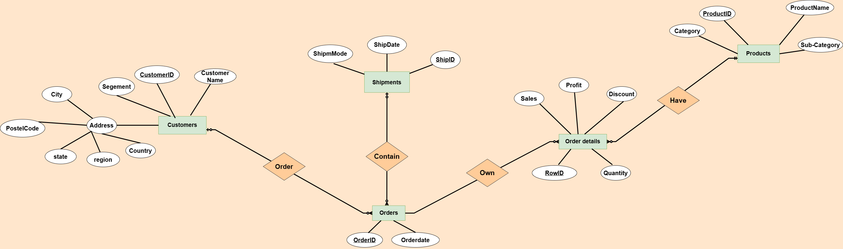
ERD diagram

Slide 6
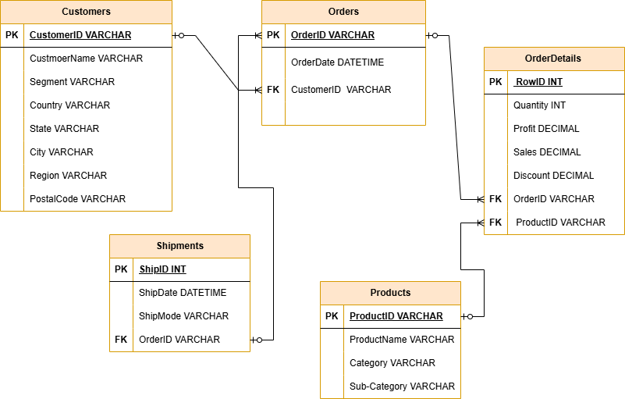
Data Schema

Slide 7
-- Table for Customers
CREATE TABLE Customers ( CustomerID VARCHAR(255) PRIMARY KEY, CustmoerName VARCHAR(255),Segment VARCHAR(255), Country VARCHAR(255), State VARCHAR(255), City VARCHAR(255), Region VARCHAR(255), PostalCode VARCHAR(255));
-- Table for Orders
CREATE TABLE Orders ( OrderID VARCHAR(255) PRIMARY KEY, OrderDate DATETIME, CustomerID VARCHAR(255), FOREIGN KEY (CustomerID) REFERENCES Customers(CustomerID));
-- Table for OrderDetails
CREATE TABLE OrderDetails( RowID INT PRIMARY KEY, Quantity INT, Profit DECIMAL, Sales DECIMAL, Discount DECIMAL, OrderID VARCHAR(255), ProductID VARCHAR(255), FOREIGN KEY (ProductID) REFERENCES Products(ProductID), FOREIGN KEY (OrderID) REFERENCES Orders(OrderID));
-- Table for Products
CREATE TABLE Products( ProductID VARCHAR(255) PRIMARY KEY, ProductName VARCHAR(255), Category VARCHAR(255), Sub-Category VARCHAR(255));
-- Table for Shipments
CREATE TABLE Shipments( ShipID INT PRIMARY KEY, ShipDate DATETIME,ShipMode VARCHAR(255), OrderID VARCHAR(255), FOREIGN KEY (OrderID) REFERENCES Orders(OrderID));
SQL Code

Slide 8

Conclusion: Summary, Recommendations, and Next Steps
Next Steps
"After exploring and cleaning the dataset, the next step is to generate key analysis questions (AQ) to uncover insights and drive data-driven decisions.”.
Summary
.The dataset contains no missing values (Non-Null Count is 1798 for all columns).
. Most columns are categorical (Object), with a few numerical (Integer,Float) and Date columns.

